Slide 1

Presentation On Documenting the memory of freedom fighters’71 in Bangladesh
Presented by
Roll: 110122
Roll: 110125
Roll: 110145

Slide 2
Presentation Layout
Introduction
Methodology
Design and Implementation of System
Conclusion

Slide 3
Introduction
The liberation war of Bangladesh has great background story.
The freedom fighters has fought bravely and defeated Pakistanis army.
But day-by-day freedom fighters is in dead and their story is disappearing .
The central intension of this project is to document their memory in terms of paper and e-doc.

Slide 4
Objectives
To know about freedom fighter’s dream about Bangladesh.
To make some documents which will be references for the next generation to know about the liberation war in absence of freedom fighters in 1971 of Bangladesh.
To store the memory and history of the freedom fighters and liberation war.
To introduce very easily the new generation with the freedom fighters in 1971 of Bangladesh and the liberation war.
To retain the inspiration of the freedom fighters of Bangladesh to the new generation and preserve the independence in 1971 of Bangladesh.
To spread out spontaneously the memory and the history of the freedom fighters in 1971 of Bangladesh in people to people, door to door, country to country and world to world.

Slide 5
Methodology
Technologies Used
Server: Apache/2.4.23 (Win32) OpenSSL/1.0.2h PHP/5.5.38
Database: MySQL
Servers Side Language: PHP (Version: 5.5.38)
Client Side Language: JavaScript
JavaScript Library: JQuery, AJAX
Markup Language: HTML
Style Sheet Language: CSS, Bootstrap (Version: 3.3.6)

Slide 6
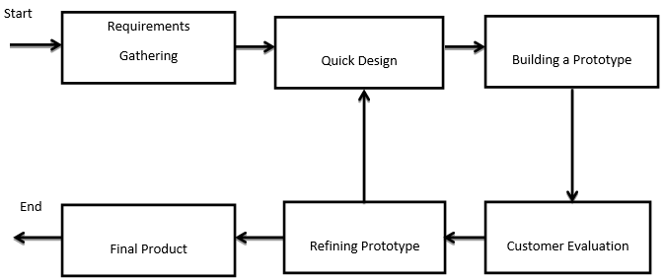
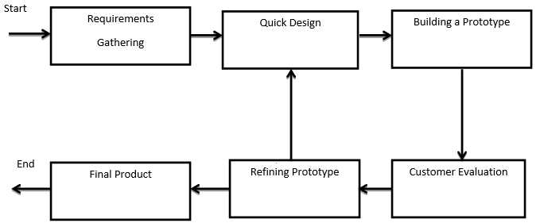
Methodology
System Modeling (Prototyping Model )

Slide 7
Methodology
Testing Steps
Unit Testing: Unit testing focuses efforts on the smallest unit of software design. This is known as module testing.
Integration Testing: Integration testing is a systematic approach for constructing the program structure, while at the same time conducting test to uncover errors associated within the interface.
Validation: Interfacing errors have been uncovered and corrected and a final series of software test begin in validation testing.
Output Testing: No system could be useful if it does not produce the required output in a specific format.

Slide 8
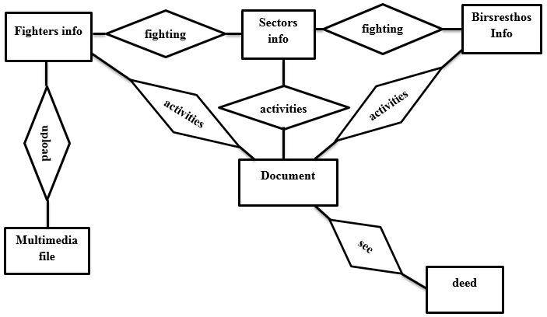
Design & Implementation of System
Entity Relationship (E-R) Diagram

Slide 9
Design & Implementation of System
System Design
Goal of system design-
The design must implement all of the explicit requirements contained in the analysis model, and it must accommodate all of the implicit requirements desired by the customer.
The design must be a readable, understandable guide for those who generate code and for those who test and subsequently support the software.
The design should provide a complete picture of the software, addressing the data, functional, and behavioral domains from an implementation perspective.

Slide 10
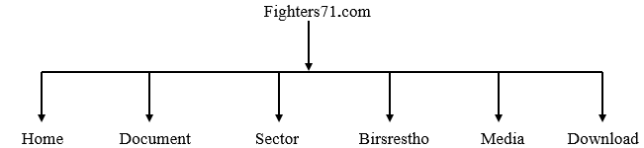
Design & Implementation of System
Navigation menu of Fighters71

Slide 11
Benefits
Special Features
The obvious advantage to show the every citizen becomes a part of the government system.
It is able to represent the whole information about the freedom fighters.
The dignity of a person is much more of his expression than wealth that is proved by the national heroes of Bangladesh in the website.
It can be able to keep any information of freedom fighters in dynamically.
It is the good categorized source for whole world people to know about the freedom fighters of Bangladesh.
It is a document for the new generation for understanding the real heroes and history of the freedom fighters of the liberation war of Bangladesh.

Slide 12
Conclusion
We have successfully completed the project Documenting the memory of freedom fighter’71 in Bangladesh. With this project, every person is knowing about the liberation war of Bangladesh. We have tried to bind the history and dedication of the freedom fighters of the liberation war of Bangladesh in our small frame in http://fighters71.com.

Slide 13
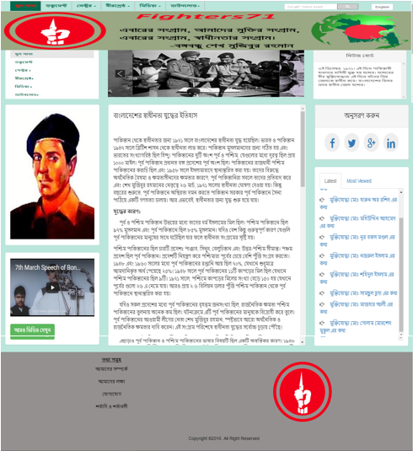
Snapshots

Slide 14
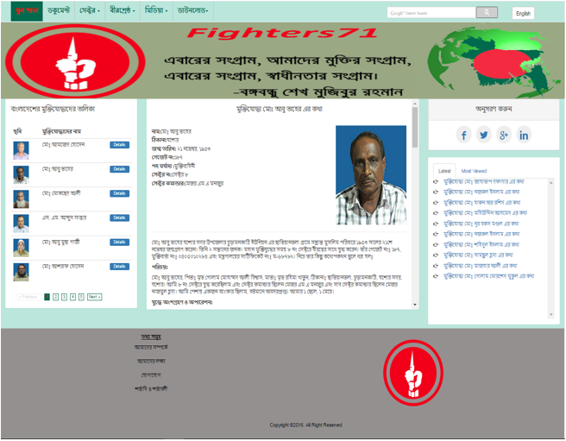
Snapshots

Slide 15
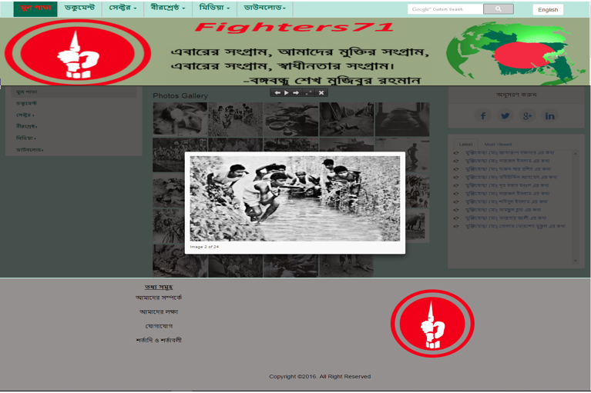
Snapshots

